Slide 1
An Overarching Newtonian Framework
Ryan Fielder and Jonah Friedrich

Slide 2
God as a Mathematician
“Philosophy is written in this grand book, the universe, which stands continually open to our gaze. But the book cannot be understood unless one first learns to comprehend the language and read the letters in which it is composed. It is written in the language of mathematics, and its characters are triangles, circles, and other geometric figures without which it is humanly impossible to understand a single word of it; without these one wanders about in a dark labyrinth.” - Galileo Galilei, The Assayer

Slide 3
Coherence in Science
Vertical Coherence: The ability to make detailed quantitative predictions within some domain
Horizontal Coherence: The ability to apply a concept across various fields outside its original domain

Slide 4
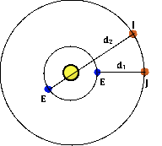
Horizontal Coherence
Olaus Roemer (1644-1710)
1675 - Determination of the speed of light
One good law used to discover another
20% off from the true value
Still a huge discovery!! Light has finite speed
Measuring the Speed of Light

Slide 5
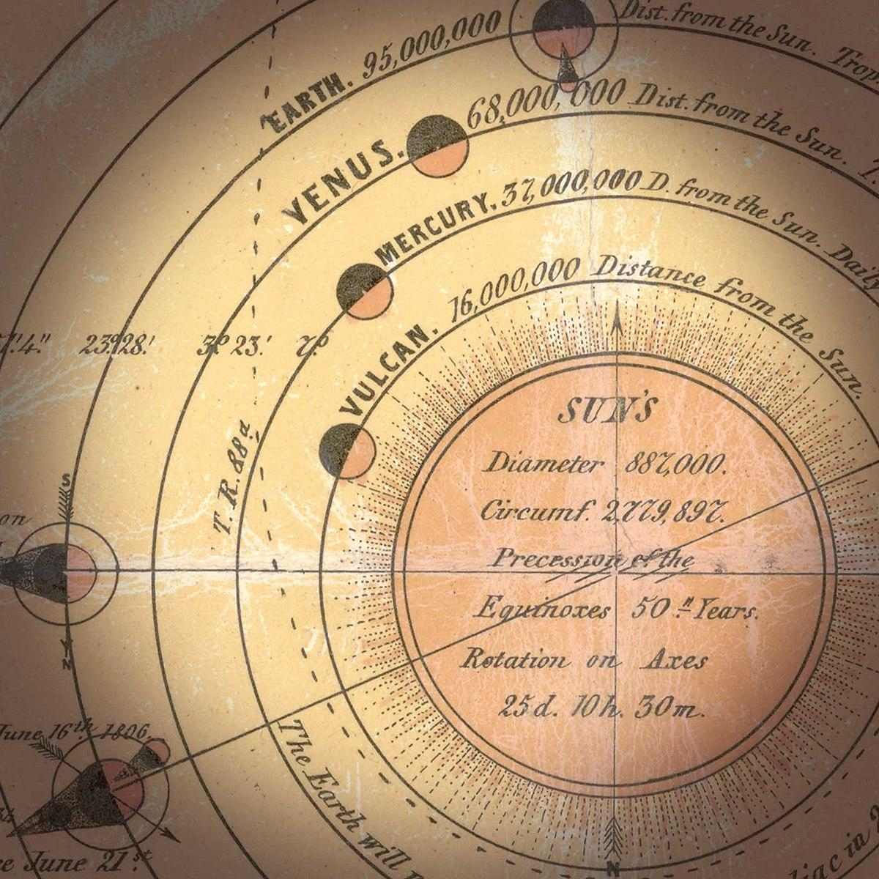
Vertical Coherence - Neptune, Pluto, Vulcan
Leverrier and Galle discovered the planet Neptune based on applying Newton’s law of universal gravitation to the orbit of Uranus, but even if accounting for Jupiter and Saturn, the orbit is incorrect. This is because another planet, Neptune exists and perturbs the orbit.
Same concept was applied to find Pluto
And again, for the planet Vulcan

Slide 6
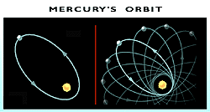
Vulcan - a Lack of Vertical Coherence
There is a precession in the orbit of Mercury not explained by classical perturbation theory
Leverrier posited a planet Vulcan as the cause of this perturbation, but it was never found
Instead, a 1/r³ term could be added, but this explanation is ad hoc and for a limiting case
Eventually, this led to some of the discoveries in Relativity

Slide 7
Before Newton
Nicolaus Copernicus (1473-1543) “Instrumental” Heliocentrism
Tycho Brahe (1546-1601) developed improved data of planetary motion
Johannes Kepler (1571-1630) empirically developed his three laws
Galileo Galilei (1564-1642) studied idealized situations and extrapolated his concept of inertia

Slide 8
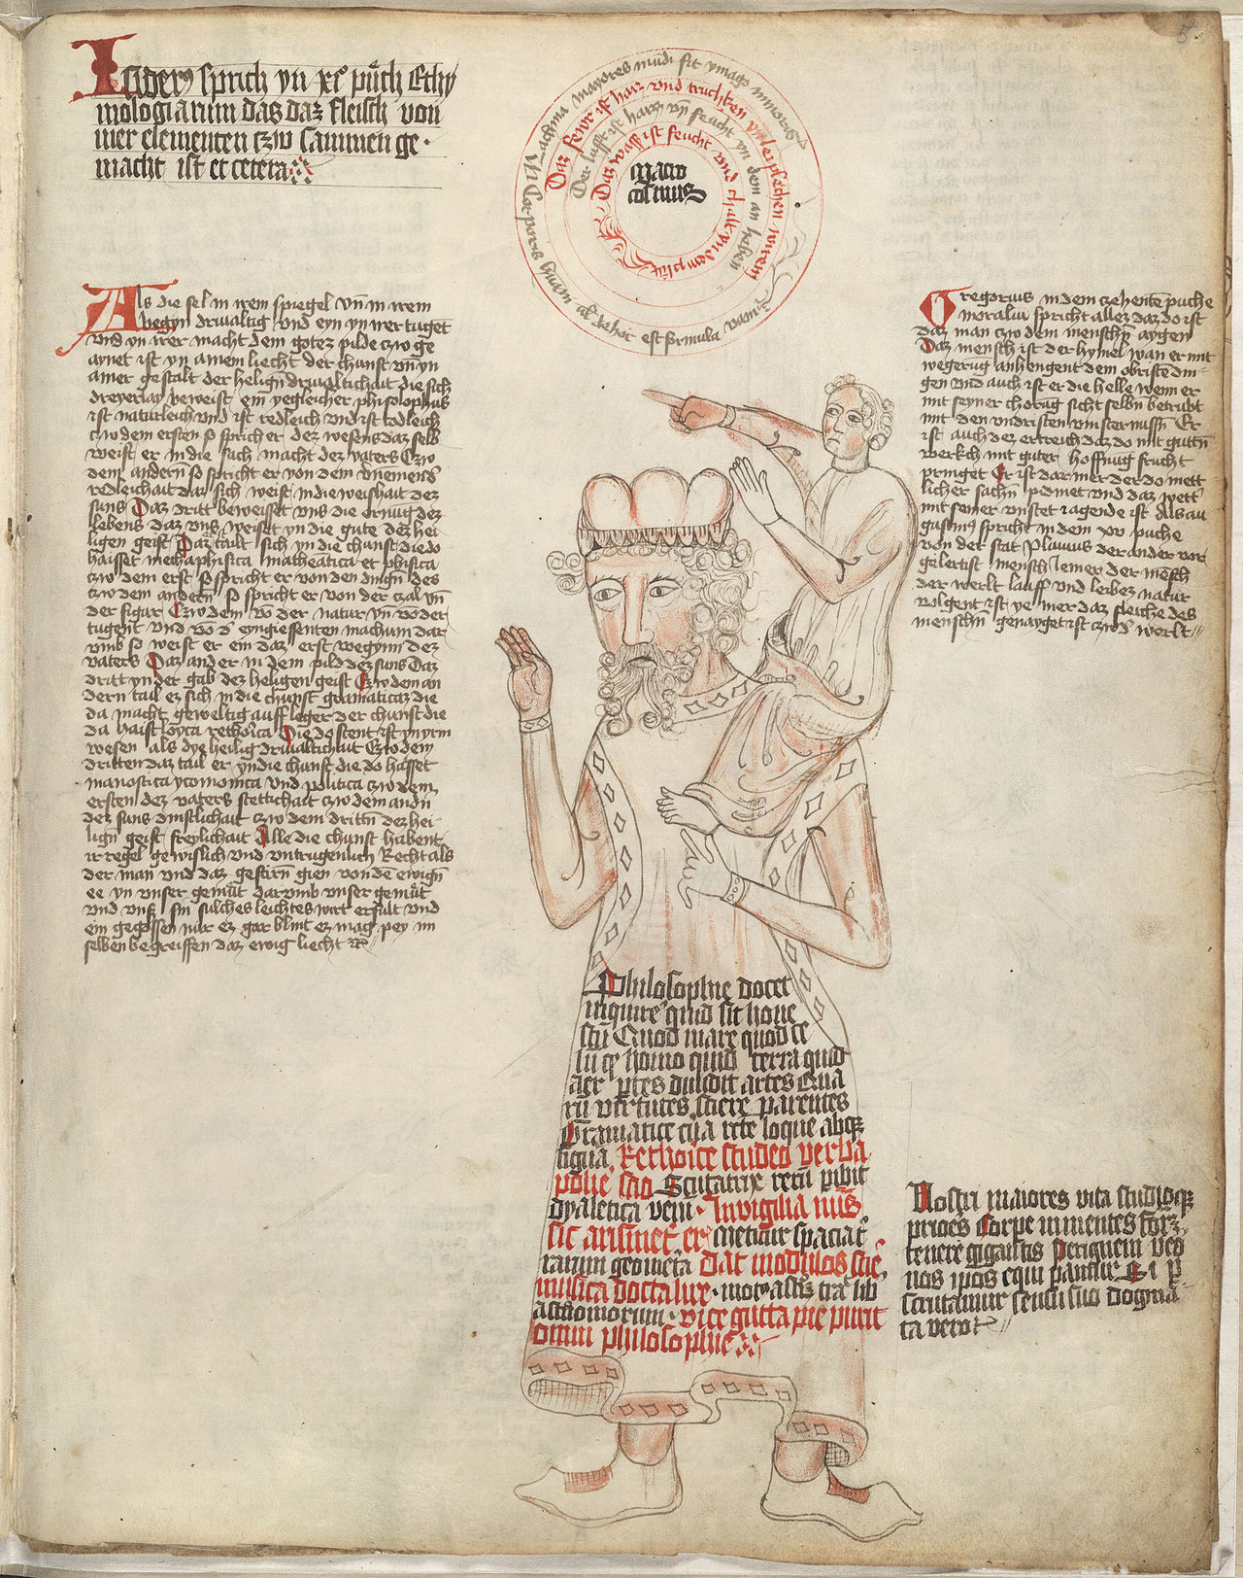
Steps, not Leaps
Newton unifies previous data, concepts, and laws with his own laws of inertia and gravitation
"If I have seen further, it is by standing on the shoulders of giants."

Slide 9
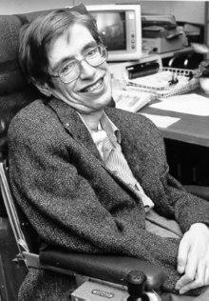
After Newton
Newton’s laws of gravity are good approximations, but not accurate as a real model of the universe
Developments are still being made
Einstein’s GR was a more accurate description of the world Newton described
Stephen Hawking, and others, have worked to create a unified field theory
August 14, 2017 Gravitational Wave Detection

Slide 10
Theory of Everything?
Notes:
https://www.youtube.com/watch?v=lqk3TKuGNBA

Slide 11
Evolution of Space

Slide 12
Atomistic Space
Stresses the physical character of space itself
Infinite emptiness that contains motion of matter with no influence

Slide 13
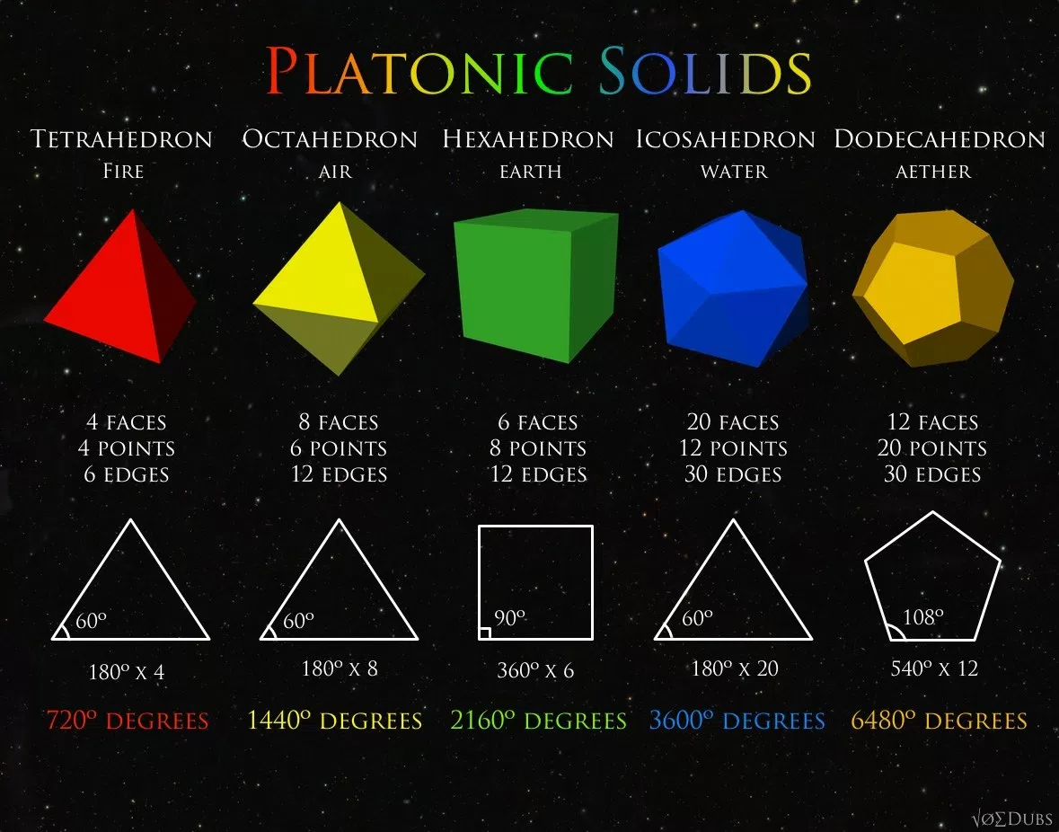
Platonic Space
Stresses the connection between space and matter using geometry
Water = icosahedron
Air = octahedron
Fire = pyramid
Earth = cube

Slide 14
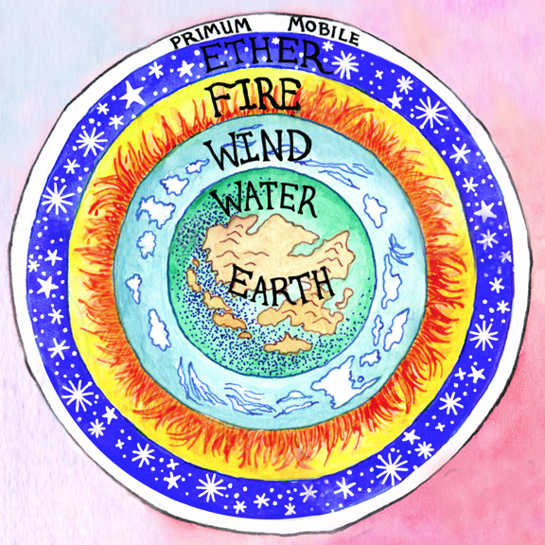
Aristotelian Space
Stresses the causal nature of space
No void because space determines the natural motion of bodies

Slide 15
Absolute Space
Space and its structure are part of the empirical science of mechanics.
Absolute space exists independently of material objects
Relative space is what we determine by the position of material bodies
Absolute motion cannot be detected kinematically
Famous “Bucket Thought Experiment”

Slide 16
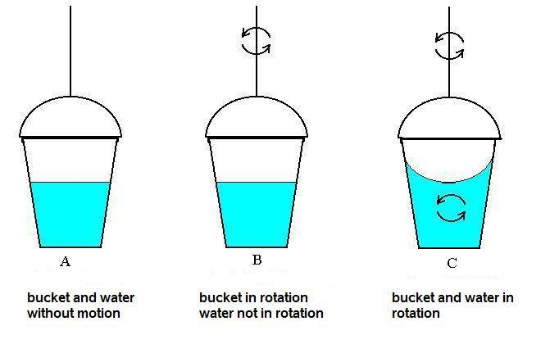
Mach’s reply to the Bucket Experiment
We cannot actually empty the universe of all matter to see how the bucket would interact
We can only conjecture what the surface of the water would look like
In reality, we need to take space as relative to the heavenly bodies
With this, Newton’s argument loses its force

Slide 17
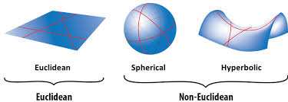
Physical Space vs Mathematical Space
Physical space pictured with Euclidian geometry (flat geometric plane)
Mathematical space can be pictured with non-Euclidian geometry

Slide 18
“We were on a walk and somehow began to talk about space. I had just read Weyl’s book Space, Time and Matter, and under its influence was proud to declare that space was simply the field of linear operations.
‘Nonsense,’ said Heisenberg, ‘space is blue and birds fly through it.’”
Felix Bloch (1905-1985) conversation with Werner Heisenberg (1909-1976):

